Slide 1

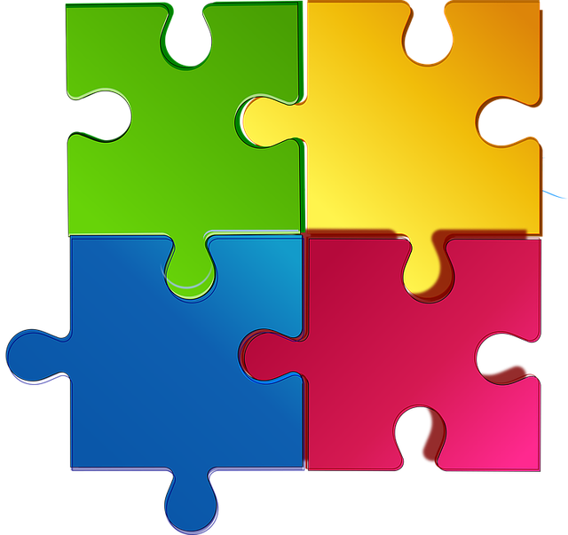
Move a Tile – Win a Jigsaw Fifteen Puzzle
Keerthi Reddy Ellanki Prashanthi Koudi
Akshar Patel

Slide 2
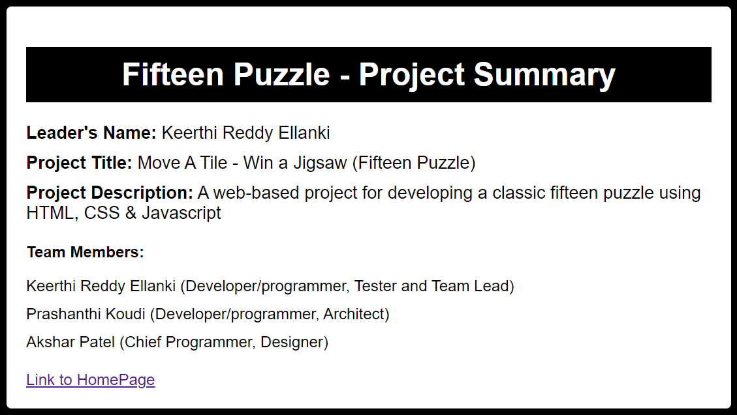

Slide 3
Problem Statement
The classic fifteen puzzle is a 4x4 grid of numbered square tiles from 1 to 15 plus one open space. The tiles can slide horizontally or vertically into the open space, with the goal of achieving the correct numeric order from 1 to 15 left to right, top to bottom.
This popular puzzle game presents challenges in efficiently finding the solution in as few moves as possible. The front-end web app should have an engaging UI and intuitive controls for easy puzzle solving.
The problem is to develop an engaging, interactive fifteen puzzle web application using only HTML, CSS and JavaScript where users can intuitively solve puzzle grids of varying difficulties in a clean browser-based interface with dynamic audio and visual feedback.

Slide 4
Solution Overview
The core foundation of the fifteen-puzzle web app will be built using HTML5 & CSS3 to create the visual building blocks of the game.
This will include semantic HTML structure to display the 4x4 grid that holds the puzzle tiles, representing each tile and the open space as individual <div> elements that can be manipulated.
The CSS will handle the visual styling like colors, borders, background images to depict the tiles, animations and transitions for smooth sliding movement, and page layout in a responsive grid for any device. Design choices through CSS will also establish the overall theme.

Slide 5
Solution Overview – Contd..
The brains behind executing the puzzle logic and game mechanics will lie with in JavaScript code. This includes key tasks like binding drag events so the user can click and slide tiles with their mouse or touch input, dynamically checking that each tile move is valid against the rules before animating, tracking the tiles order and positions throughout to determine if the puzzle is solved.
Together, HTML markup, styling and interactive scripts will deliver a well-designed, visually polished and performant fifteen puzzle application for desktop and mobile, avoiding complex backend infrastructure.
The key technical priorities are flawlessly smooth tile sliding, intuitive controls and an engaging, theme-based visual appearance.

Slide 6
Key features
End-of-Game Notification: When all the tiles have been re-arranged correctly by the player, the background image changes stating that the player has won the game. It also shows the best time and best moves taken by the player previously.
Animations/Transitions: When we first hover over a tile(puzzlepiece), the style of the text on it changes for the first time. And, the tiles which have the chance to move (which are around the empty tile) has the ability to change the style of text on it when the player hovers over them. Game time with some music file: When the player starts the game, it shows the time, moves taken by the player to complete the game. During the game, a soothing music plays in the background.

Slide 7
Key features – Contd…
Multiple Backgrounds:
The game chooses the random background on startup and has the ability to select different backgrounds while playing
Multiple Grids: The game allows the users to select different sizes of grids to play according to the level of easiness.
Cheat Button: This button solves the puzzle and moves the tiles to their original places same as original
Stop Button:
When the player stops the game, the background image changes stating that the player has lost the game.

Slide 8
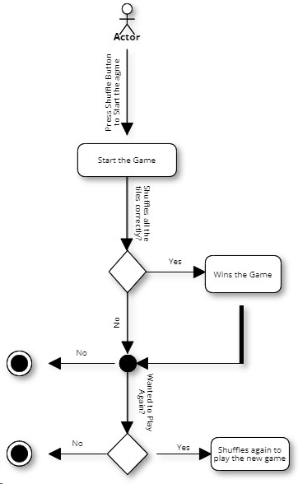
UML Diagram

Slide 9
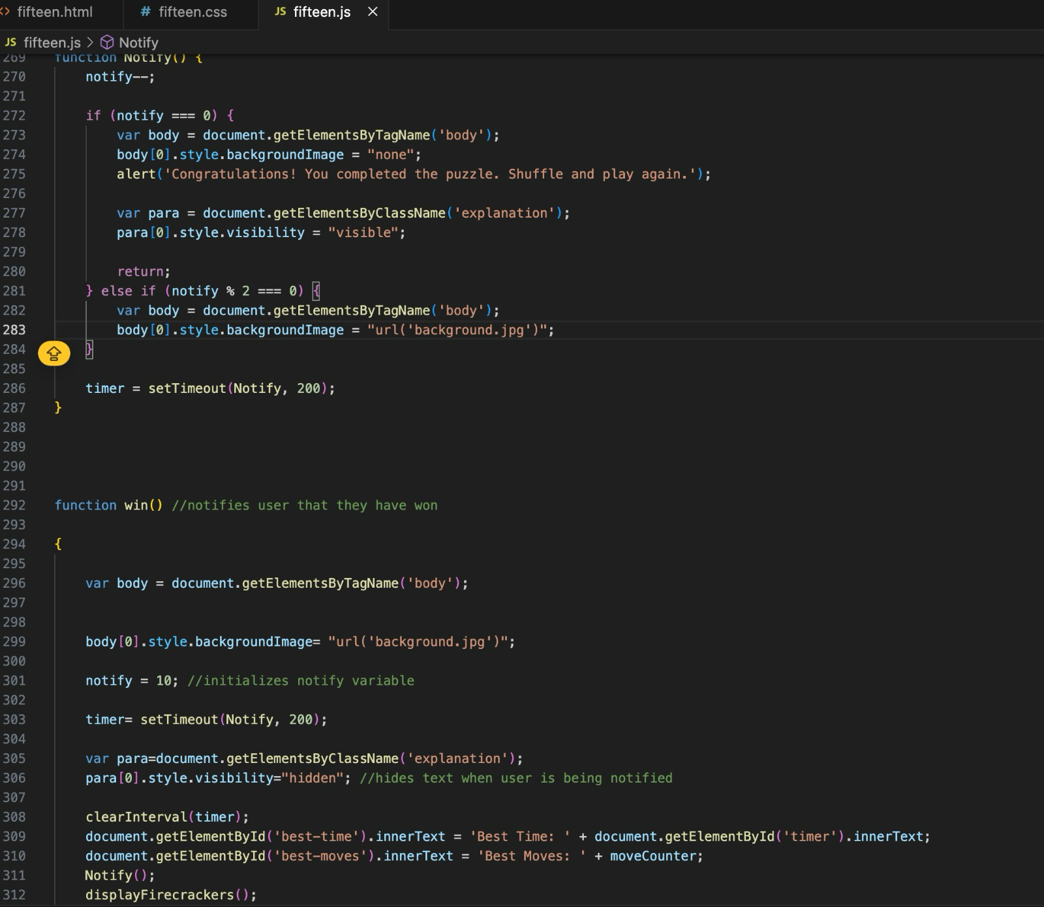
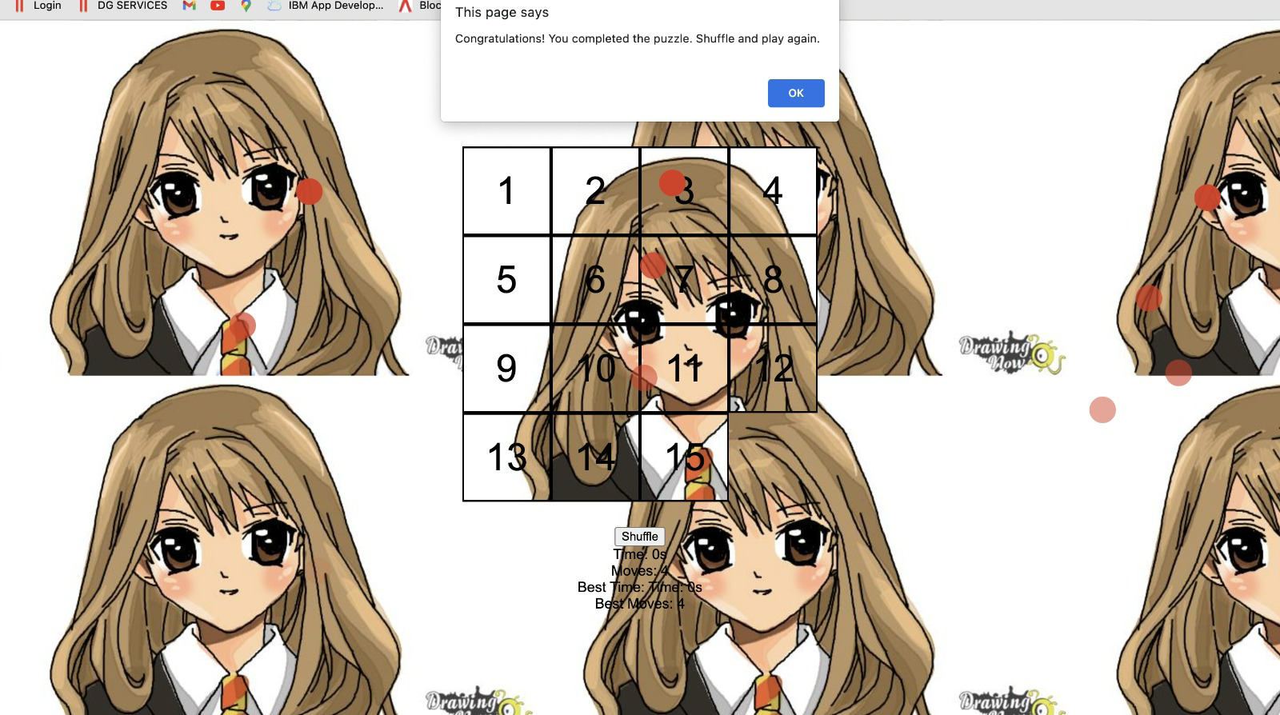
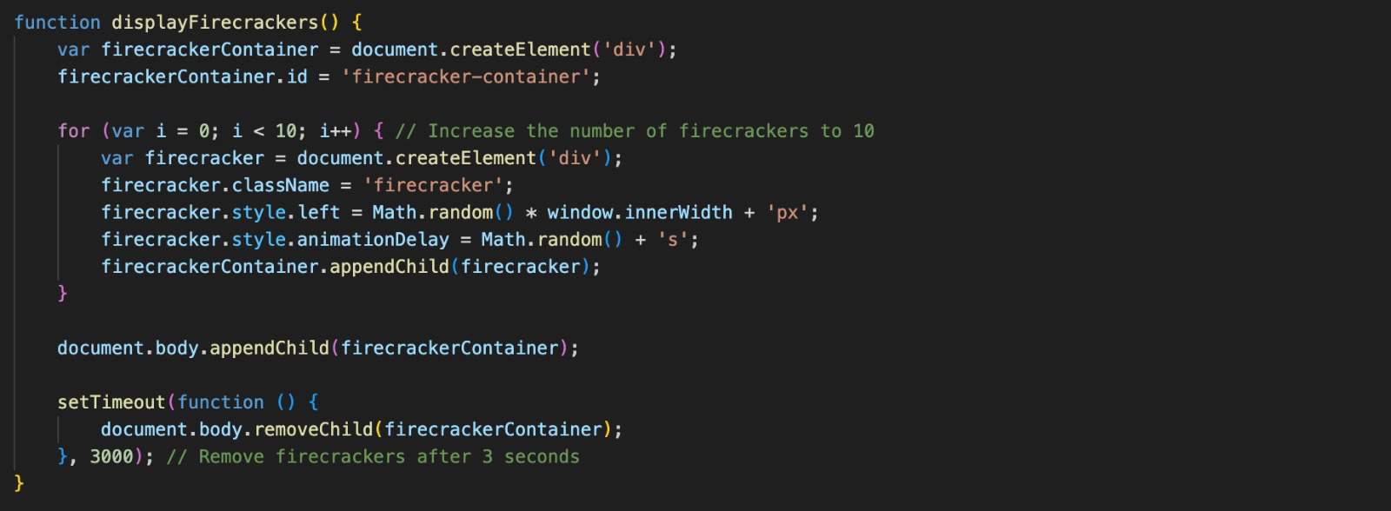
Code Snippets (End of the game notification)

Slide 10
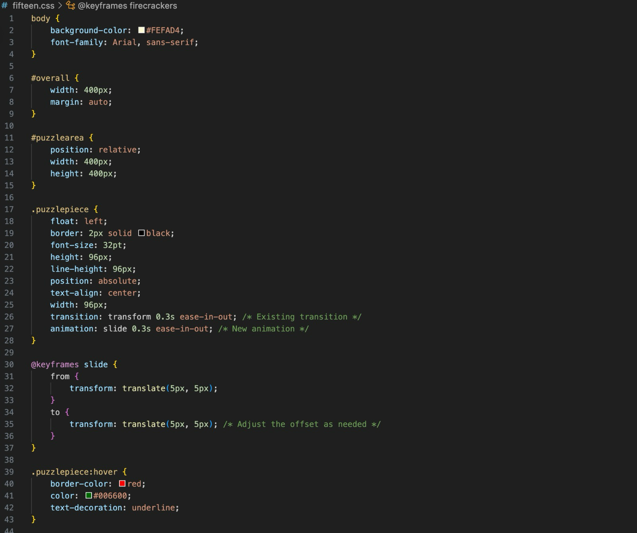
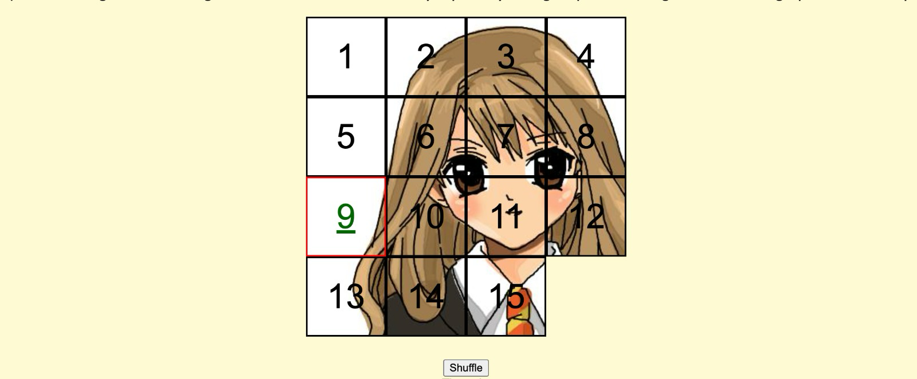
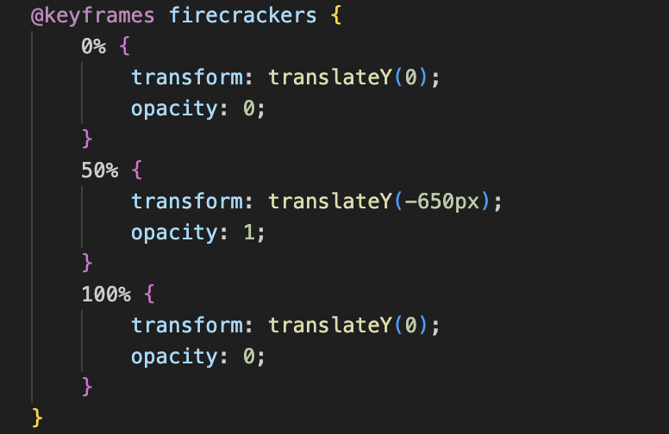
Contd (Animations and Transitions)…

Slide 11
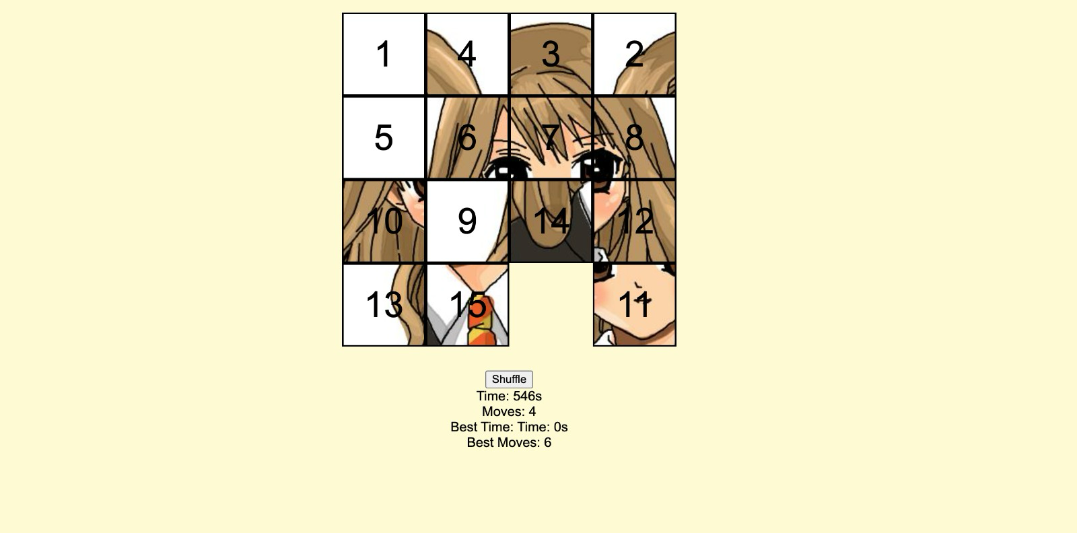
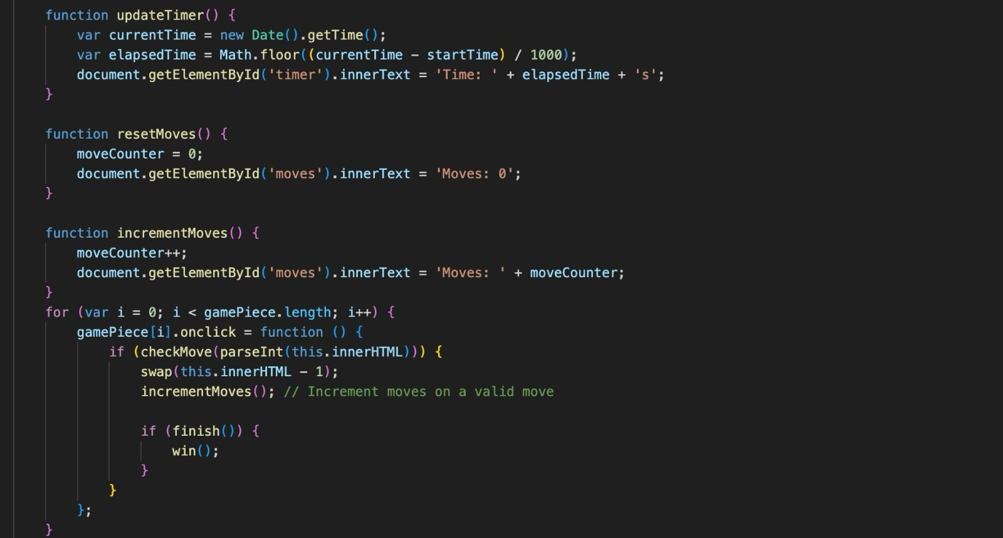
Contd (Time, Music and Moves)…

Slide 12

Contd (Multiple backgrounds)…

Slide 13
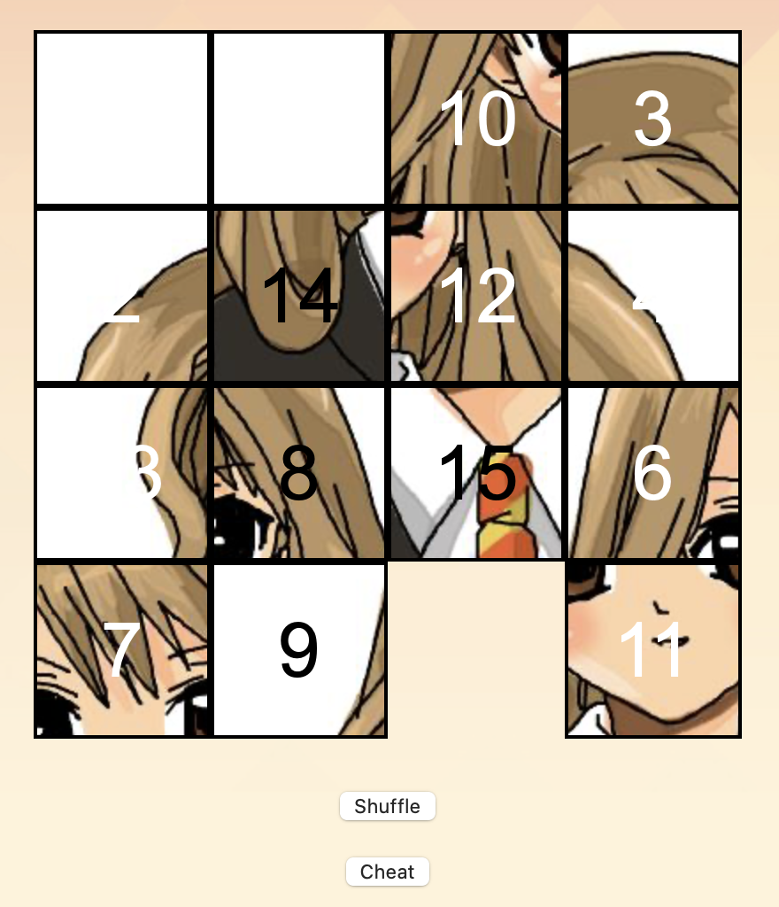
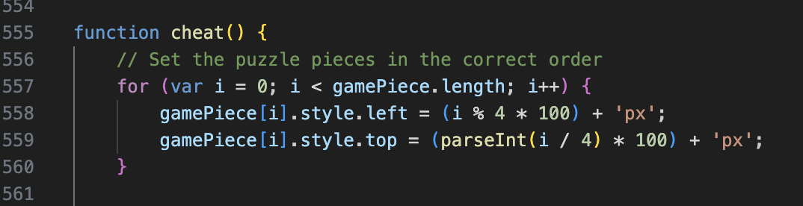
Contd (Cheat Button)…

Slide 14
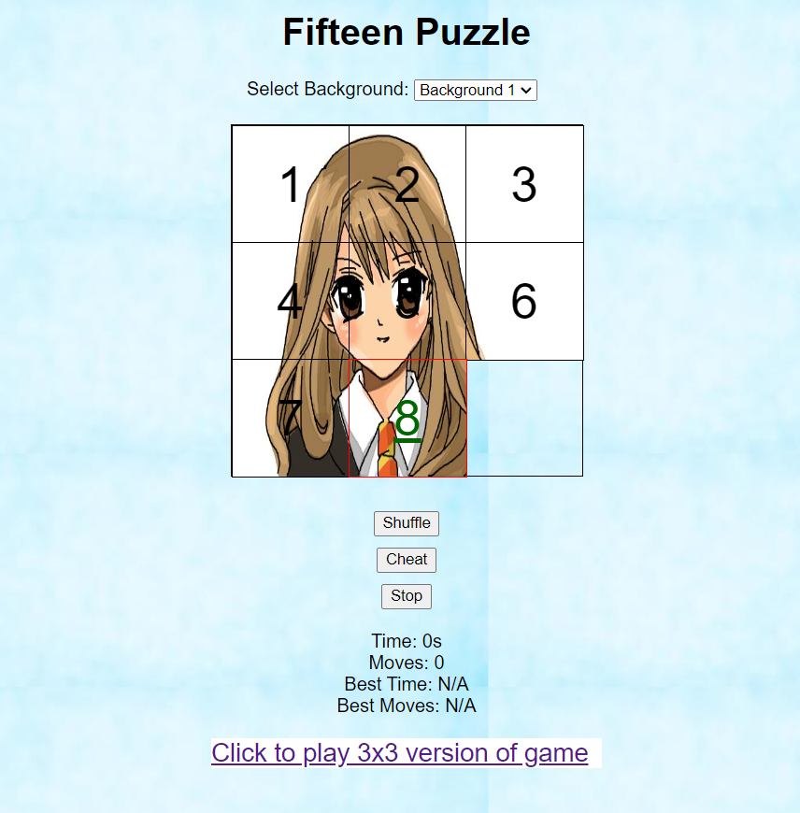
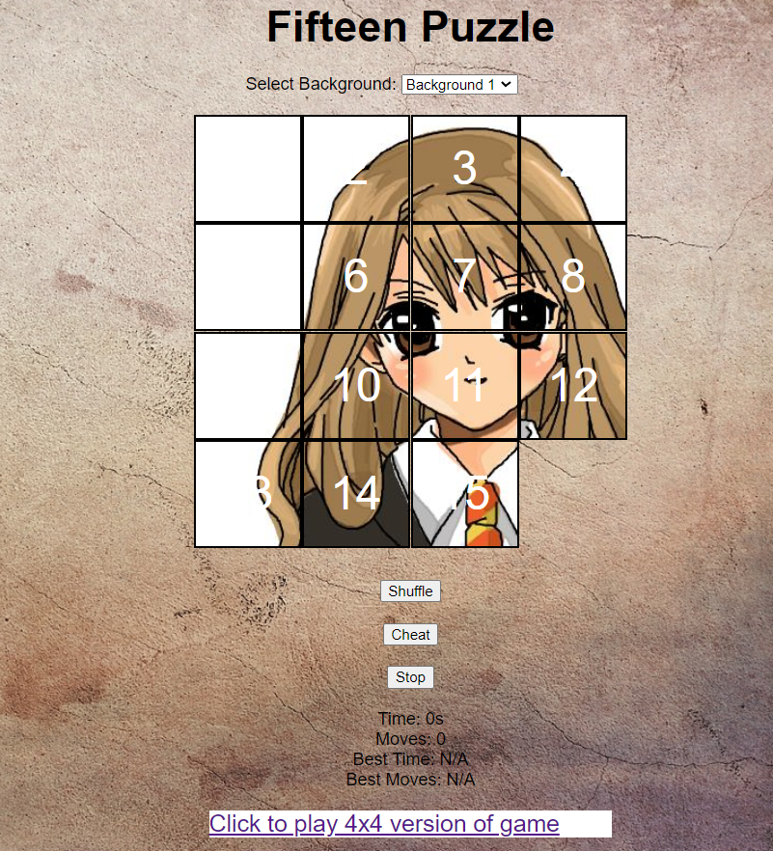
Multiple Grids…

Slide 15
DevOps Methodology
Plan & Design
Gathered core requirements for puzzle grid, game logic, UI controls
Mapped out conceptual design - sketched wireframes/storyboards of visual flow
Brainstormed theme ideas/visual assets that could enhance appeal
Prioritized must-have features, nice-to-haves for possible technical debt backlog
SetUp
Initialized Git repository on hosting service like GitHub for source control
Configured issue tracking/project boards to manage tasks and defects
Setting up Kanban board for coordinated team workflow

Slide 16
DevOps Methodology – Contd…
Develop
Developed Modular front-end web architecture - separated HTML, CSS, JS files
Used Agile sprints to tackle batches of high-level feature Incrementally expand functionality while refactoring along the way
Emphasized clean, well-documented code and peer reviews
Test
Performed Cross-browser validation on UI appearance, responsiveness, interactions
Unit tested critical components like move validity resolver logic
Done Manual end-to-end testing exploring all paths to uncover gaps , fix defects rapidly by triggering new lightweight release builds

Slide 17
Link to project home page-
https://codd.cs.gsu.edu/~apatel392/wp/project/3/fifteen.html
Link to project summary page –
https://codd.cs.gsu.edu/~apatel392/wp/project/3/info.html
Link to YouTube ppt presentation –
https://youtu.be/8YeRKYCoBCQ?si=87iCqtQE9ryTxmQQ
Link to GitHub Repository –
https://github.com/akshar-26/Project-3

Slide 18


